Slide 1

Session 7:
SEO
Internationalization and Localization

Slide 2
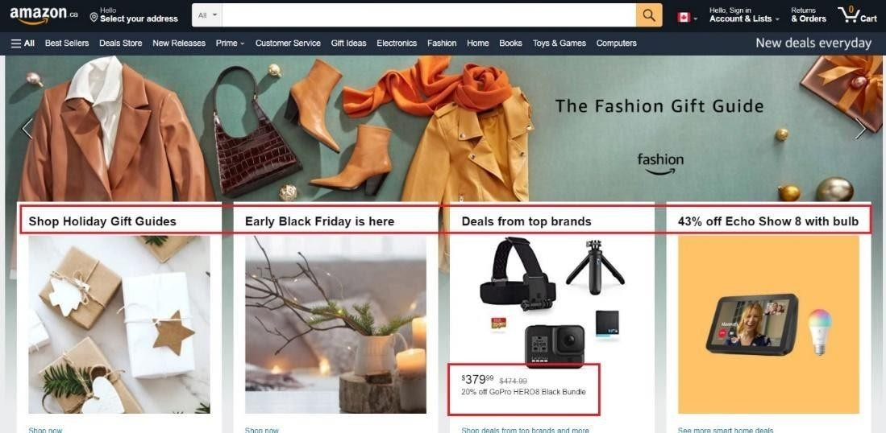
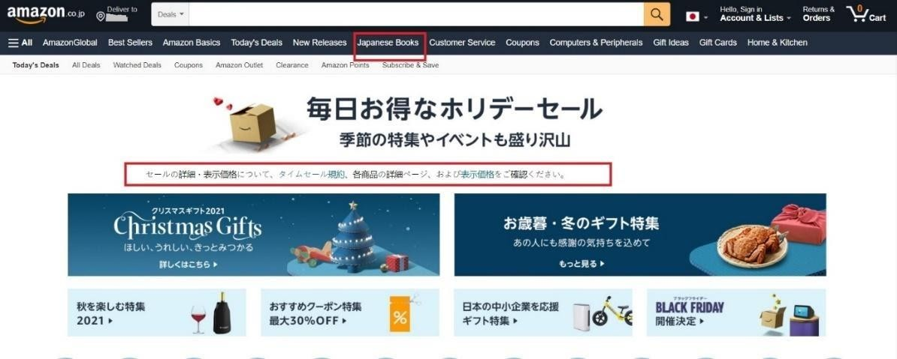
SEO Localization 1-2
Amazon Website for Canada
Amazon Website for Japan

Slide 3
SEO Localization 2-2
Amazon Website for Canada
Amazon Website for Japan
Develop source text for SEO localization
Extract key terms from the source
Add suggested topics in the target language to the keyword list Find a match between the source terms and target terms
Use Computer Assisted Translation (CAT) Tools Proofread the translation
Localize remaining elements
Steps to achieve SEO localization

Slide 4
SEO Internationalization
Relevant Information for Target Audience
Language Meta Tags
URL structures
ccTLD
Local language
Sub- domain
Currency
Sub- directory
Time Zone
gTLD
Cultural differences
Different domain name

Slide 5




















Social Media Optimization and its Role in SEO
Select the right social media platform
Incorporate visual content
Participate in Forums
Use hashtags
Encourage employees to share
Analyze Audience
Implement competitive analysis
Define strategy
Execute strategy
Analyze
results

